Slide 1
TAP LIGHT UP WORKSHOP
Project Created By: Jared Alt, Sterling Abrams, and Anh Thu Nguyen

Slide 2
About TAP
TAP otherwise known as the Technology Ambassador Program is an award winning program at GGC which aims to
Increase interest in programming the the number of students who commit to an IT major.
Provide outreach opportunities for GGC students through developing games and programs and presenting them to introductory STEM courses
Develop soft skills

Slide 3
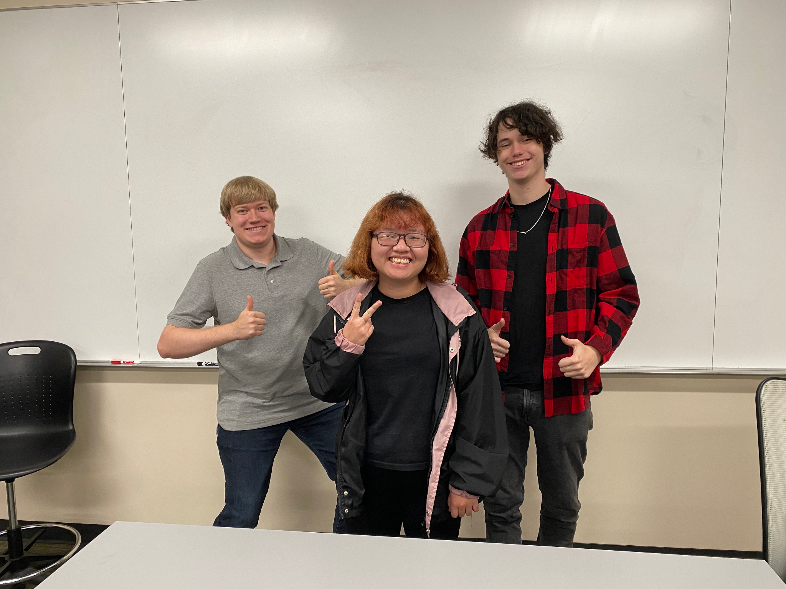
The Creators!
From left to right
Sterling Abrams, Anh Thu Nguyen, Jared Alt

Slide 4
Meet The Creators (Cont)
Jared:
Software Development student
No formal coding experience until this project
Sterling:
Digital media student
Advanced Scratch programing experience
Anh Thu:
Software Development international student
Intermediate in Java, C++, Scratch, Tynker

Slide 5


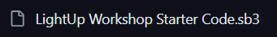

Download Starter File
Go to GitHub: TAP-GGC/LightUp-Teaching-Programming-Basics-with-Scratch (github.com)
Open the Documents -> LightUp Starter Files folders
Download the “LightUp Workshop Starter Code” by clicking the download button at the top right

Slide 6




Download Starter File – Part 2
Go to Scratch: https://scratch.mit.edu/
Click Create at the top of the page:
When your new page opens click “File” at the top of the page and select “Load from your computer”
Find where your .sb3 is and select “Open”

Slide 7
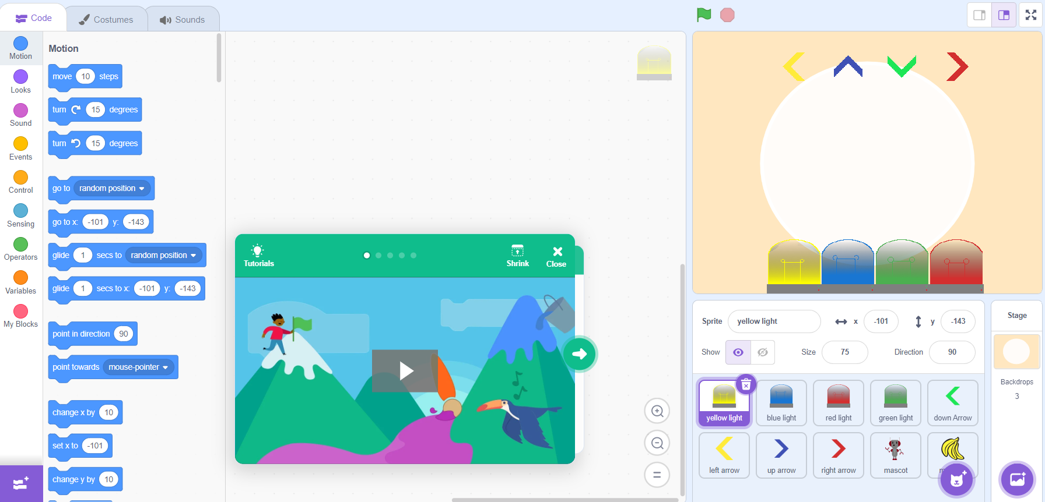
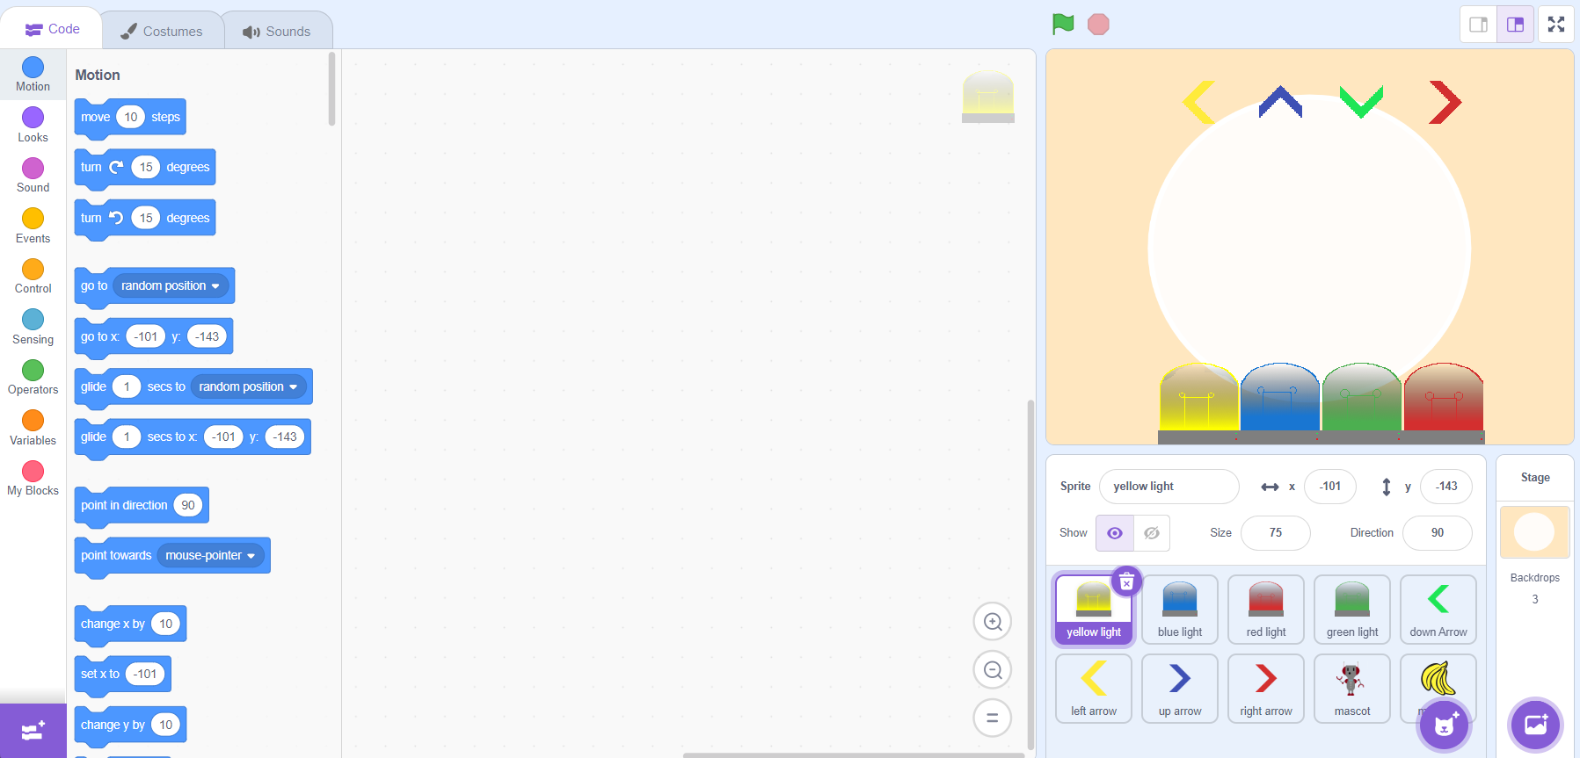
Download Starter File – Part 3
Let Scratch load your project and now your ready to start the workshop.
TIP: Close the green pop-up box that shows tutorials as you don’t need it

Slide 8
Introduction to Scratch

Slide 9
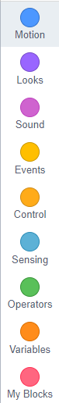
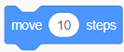
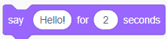
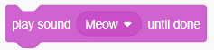
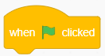
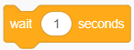
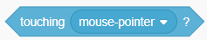

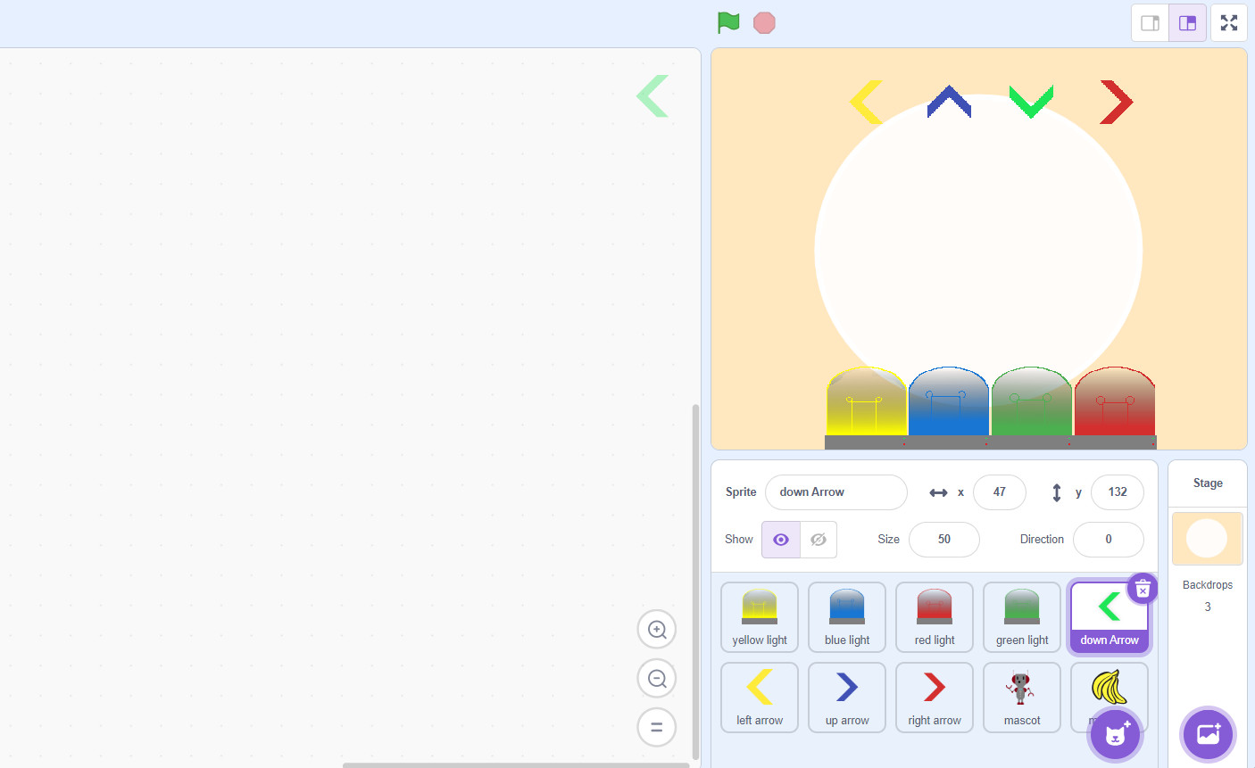
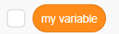
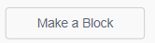
Get Familiar With Scratch
On the left, Scratch has organized the code blocks into different categories and each categorgy have their own coding blocks
The middle of your screen is the workspace and where we will place our code
On the right, is where the game will be displayed and where we will also be able to select the sprite we want

Slide 10
Get Familiar With Scratch – Part 2
Sprites is what Scratch calls an object or an image. They can be anything such as animals, shapes, or characters, but today we will be using lightbulbs and arrows.
They are going to be shown at the bottom right of our screen
You will know that you are working on a sprite if there is a purple box around the object

Slide 11
Get Familiar With Scratch – Part 3
At the top right of Scratch, you will see our “game-screen” this is where our sprites and the code will work together to make our game.
The green flag at the top is how we run our code, and the stop sign will stop any of our animations
Now let’s get coding!

Slide 12

Get Familiar With Scratch – Part 4
The most important thing is to make sur that you have the correct sprite selected at the bottom of your screen when coding
We will first start coding for the yellow lightbulb, so make sure you click the sprite at the bottom.

Slide 13
LightUp Workshop Part 3

Slide 14
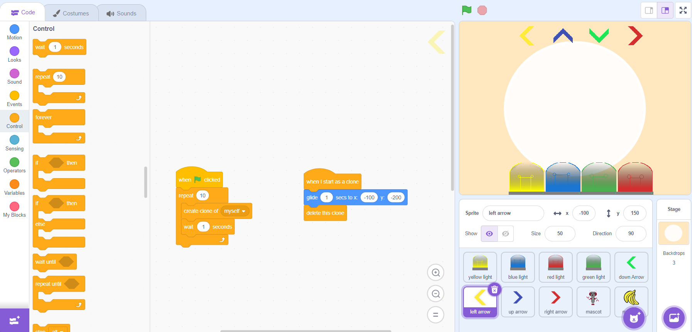
Hit Registry
For the third part of the workshop, we are going to track when an arrow “hits” a lightbulb
This is so when the user hits the correct arrow, we can then give them a point
To start make sure that your left (yellow) arrow sprite is selected.

Slide 15
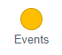
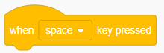
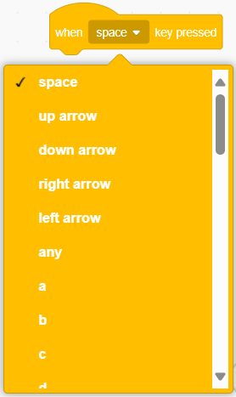
Hit Registry – Part 2
o To grab a beginning block, go the Events category
Find the “When ____ key pressed”, click and drag it to the workspace
o There is a drop-down menu for you to select what key triggers the code, select the “left arrow”

Slide 16
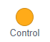
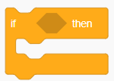
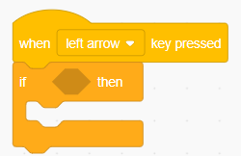
Hit Registry – Part 3
o Go to the Control category
Grab the first “If ____ then” block.
Drag the block to your work area and place it underneath the “When _____ key pressed” block.

Slide 17
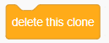
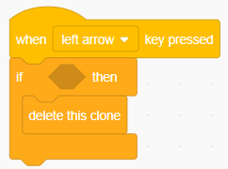
Hit Registry – Part 4
o In the Control category find “Delete this clone”
Drag the “Delete this clone” in the workspace
Place the block in the “If _____ then” block

Slide 18
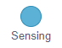
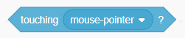
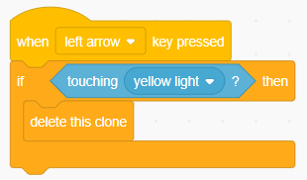
Hit Registry – Part 5
o Go to the Sensing category
Drag the “Touching ________?” in the workspace
Place the block in the empty space of the “If _____ then” block. Click the dropdrown menu for your block and select the “yellow light} option.

Slide 19
Hit Registry – Part 6
o What we have just added is called a Boolean condition. This is a condition that must either be true or false. If our condition is true, so the arrow is touching the lightbulb, then we will be able to enter the if block and run the code we placed in there. If our condition is false, so the arrow is not touching the lightbulb, we will not do anything.

Slide 20
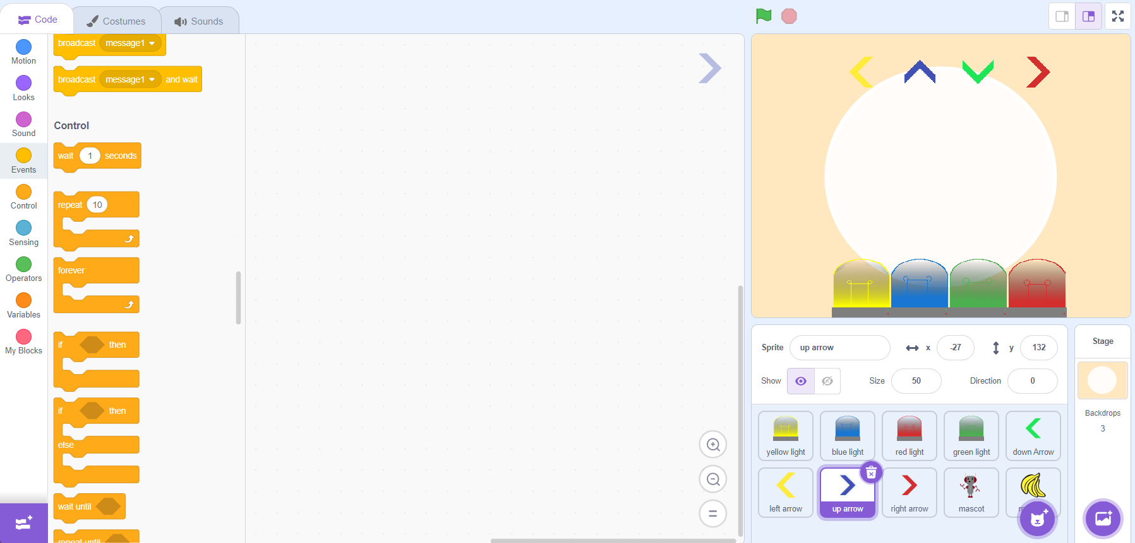
Your turn
If your code works, congratulations you have now tracked when a arrow is touching a lightbulb. Later we will use this logic to help us give points
Follow the same steps to add the same animations for the rest of the arrows
Make sure to select the sprite you want to work on

Slide 21
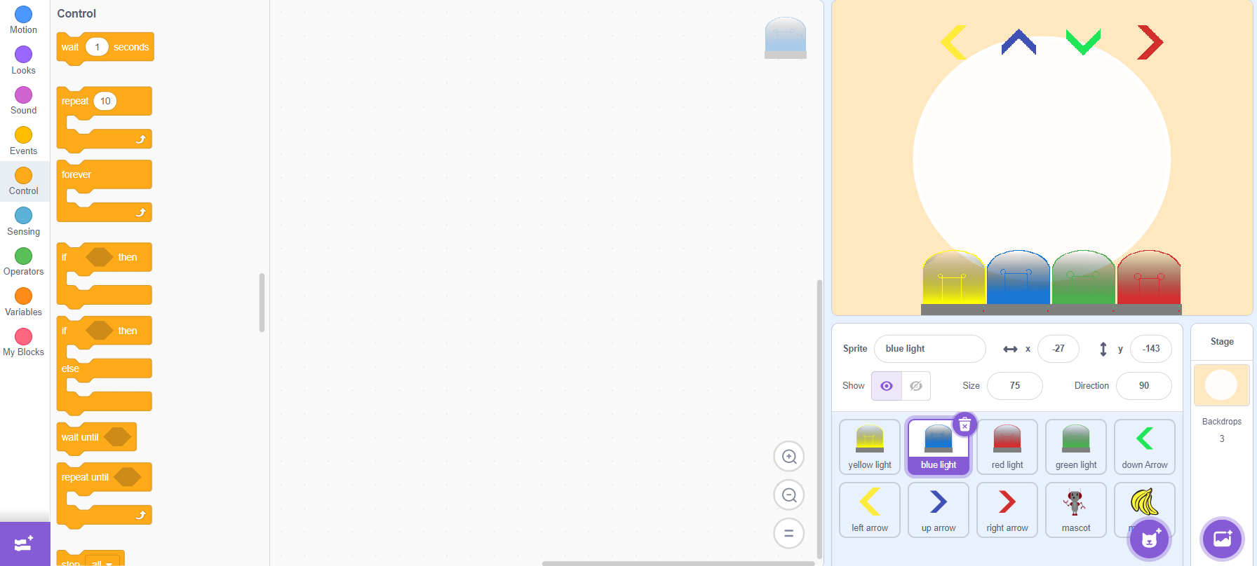
Your turn – Part 2
Use the “up-arrow” for blue arrow
Use the “down-arrow” for green arrow
Use the “right-arrow” for red arrow

Slide 22
LightUp Workshop Part 4

Slide 23
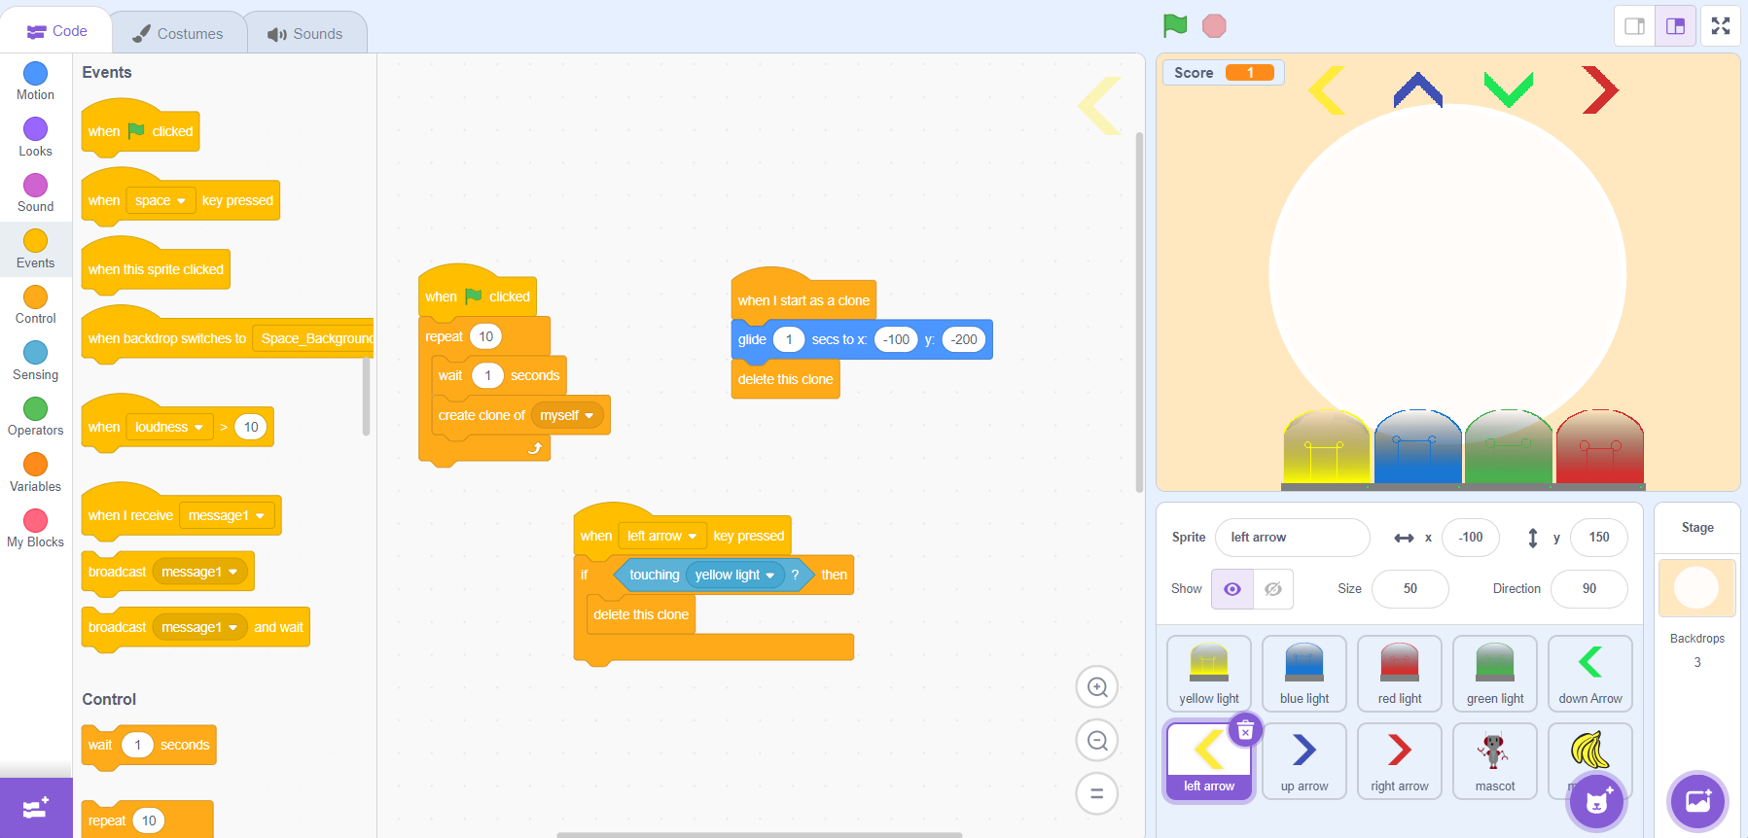
Add Difficulty
For this part of the workshop, we are going to change our animation so that all the arrows don’t fall at the same time
So, we will focus on coding the movements for the arrows at the top of our page
Click your yellow arrow again to view all your code

Slide 24
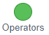
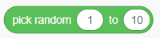
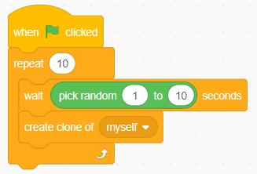
Add Difficulty – Part 2
Go to the Operators category
Find the “Pick random ___ to ___” block
Drag it your workspace and place it in the wait block that is under the “When ____ clicked” and the “Repeat ____” blocks.

Slide 25
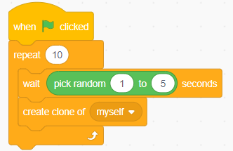
Add Difficulty – Part 3
Change the random value to wait 1 to 5 seconds
Play your game and watch how the yellow arrow doesn’t always fall at the same time as the others

Slide 26
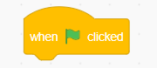
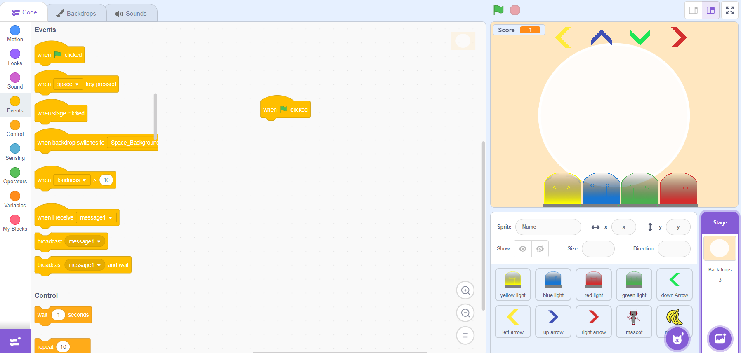
Add Difficulty – Part 4
Go to the Events category
Find the “When _____ clicked” block
Drag it your workspace.

Slide 27
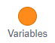
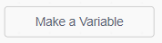
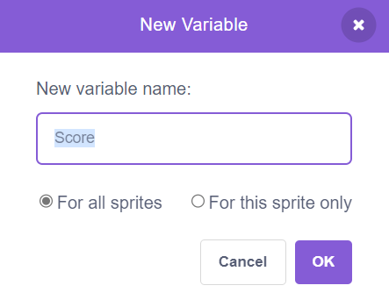
Add Difficulty – Part 5
Go to the Variables category
Find the “Make a Variable” block
Enter “Score” as the name of your variable and select OK

Slide 28
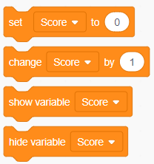
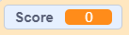
Add Difficulty – Part 6
After your new variable has been created, you should see that new blocks have been created, and a score card will appear at the top of your background

Slide 29
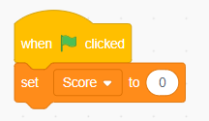
Add Difficulty – Part 7
o Drag the “Set _____ to ___” to your work area and place it under the “When _____ clicked” block
This is to make sure that everytime the user starts a new game, they start at zero

Slide 30
Add Difficulty – Part 8
Select your yellow arrow by clciking the sprite at the bottom of the page.

Slide 31
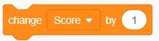
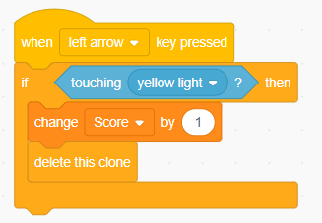
Add Difficulty – Part 9
o Go to the Variables category
Grab the first “Change _______ by ____” block.
Drag the block to your work area and place it underneath the “If touching ________ ?” block, but above the “Delete this clone”

Slide 32
Your turn
If your code works, congratulations you are almost finished with your game. You will need to add the random variables and the change score block to each of your other arrows

Slide 33
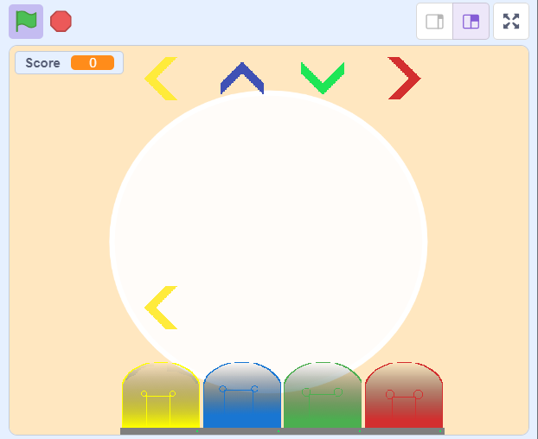
Your turn – Part 2
When you are done change some of the numbers in the game to make it difficult or easier
Happy Coding!

